Slide 1
Smart power conservation using pir
Team members
Thirumalaivasan.s
Sabariswaran.a
Vignesh.r

Slide 2
PROBLEM STATEMENT
The power consumption has been increasing rapidly due to electrical appliances to conserve energy and to make the energy available for future generation.

Slide 3
PROPOSED SOLUTION
We can overcome this problem by using Arduino board and components such as pir sensor and temperature sensor which helps to recognize humans while entering and leaving and helps to minimize the power consumption.

Slide 4
Methodology
Pir sensor and temperature sensor gets the input from the surroundings
Then it sends the corresponding output to the Arduino board .
Arduino board process the data which is driven from the sensors.
Fan and light automatically turned on according to the processed data.
When there is no change in the surrounding the fan and light automatically goes to off state

Slide 5
Hardwares Components
PIR-sensor
Temparature-sensor
Arduino board
Relay
Dc-motor(fan)
Connecting Cables

Slide 6
code
void setup()
{
pinMode(13,OUTPUT);
pinMode(7,INPUT);
pinMode(12,OUTPUT);
Serial.begin(9600);
}

Slide 7
void loop()
{
int pirvalue=digitalRead(7);
int tempvalue=analogRead(A5);
if(pirvalue==1)
{
digitalWrite(13,1);
if(tempvalue>0)
{
digitalWrite(12,1);
}
else
{
digitalWrite(12,0);
}
}
if(pirvalue==1)
{
digitalWrite(13,1);
}
else
{
digitalWrite(13,0);
digitalWrite(12,0);
}
delay(100);
}

Slide 8
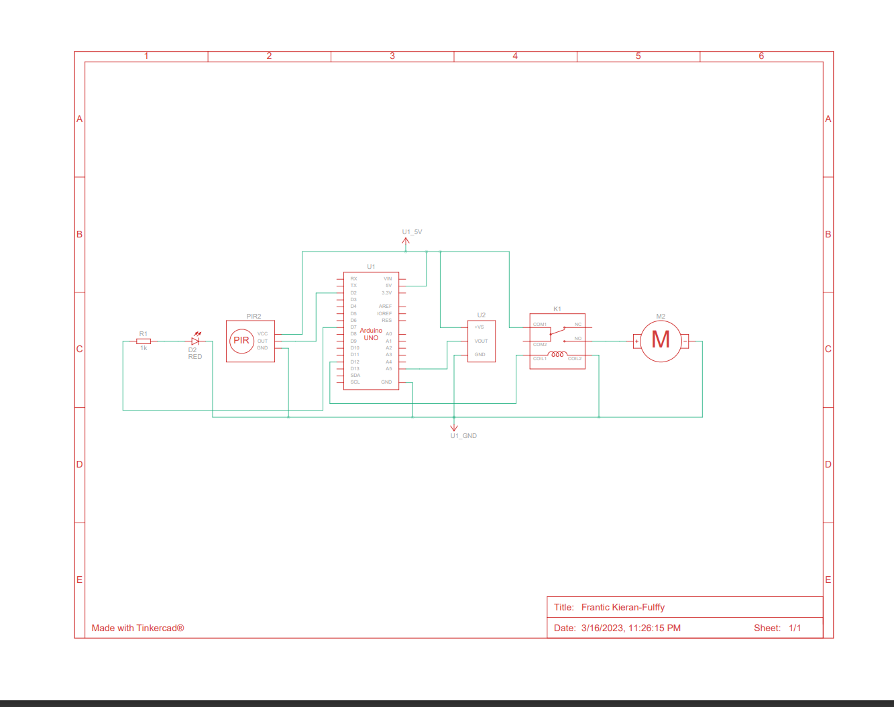
Circuit diagram

Slide 9
conclusion
Thus by using this automation we are able to save energy consumption and our suggestion is to use
replace your normal bulb to led
use smart power strips
install thermostat

Slide 10
Thank you

